Slide 1
Agenda 3-18
Do not ask about grades!
If you have to ask you probably already know…
BW – Write down everything you remember about the end of WWI
CW 1 – Practicing “Quick notes” WWI Review
CW 2 – notes on “Revolutionary” changes
HW – Goals
QOTD – “All things are difficult before they are easy.” Thomas Fuller

Slide 2
“Quick notes” tips
READ THE NOTE SLIDE!
THINK about what you read
LISTEN!
Then….write down only KEY information
Don’t copy down what you already know
DO NOT SAY “MR. TOBIN WAIT…” I WILL GO FASTER IF YOU DO!
This is supposed to be challenging… it is ok if you miss something.

Slide 3
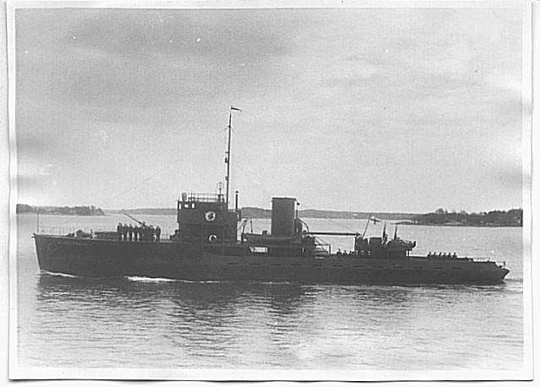
Between the Wars

Slide 4
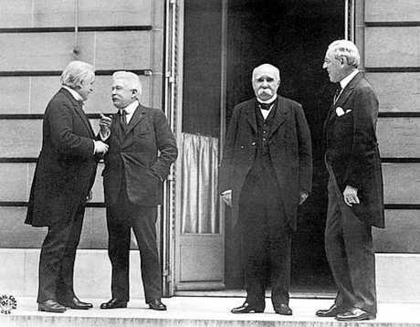
Treaty of Versailles
Ended WWI
Leaders from U.S., France, England
Wanted to create a world organization to guarantee peace

Slide 5
Britain and France
Wanted to punish Germany to ensure it would never be a threat

Slide 6
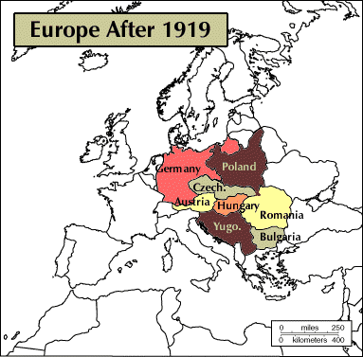
Treaty of Versailles
Territorial Losses
Land taken from Germany

Slide 7

Treaty of Versailles
Military Restrictions
Limited Germany’s army and navy
War Guilt
Germany had to accept full responsibility for the war
Pay reparations

Slide 8
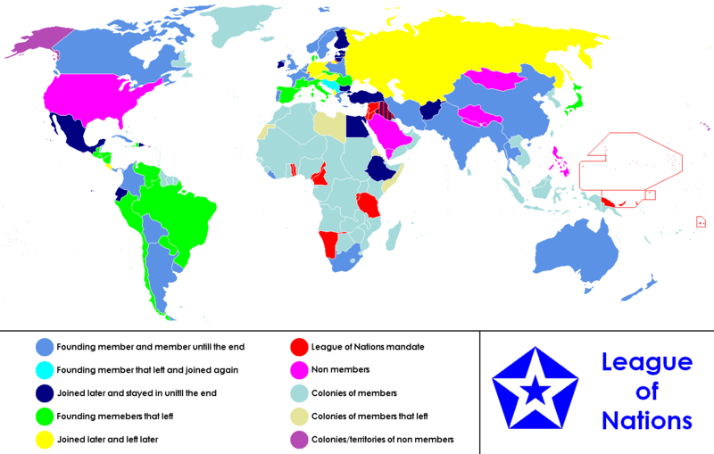
League of Nations
40 countries
Hoped to settle problems through negotiations, not war

Slide 9
League of Nations

Slide 10
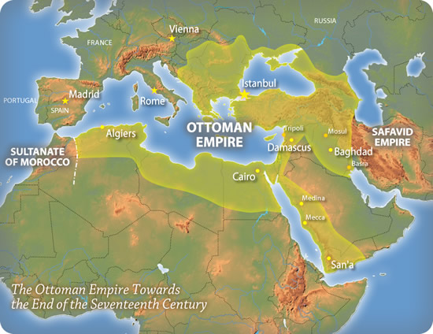
Collapse of Empires
Austria-Hungary and Ottoman Empires broken up
New nations carved out of their former territories

Slide 11
Not Satisfied
Countries had problems with the results of WWI.

Slide 12
Postwar/Interwar Years -1919-1939
Key Areas of Major changes (Revolutions)
Science
Literature
Arts
Society
Technology

Slide 13
A New Revolution in Science
Impact of Einstein’s Theory of Relativity
Albert Einstein offered new ideas in
field of physics
Theory of relativity—idea that space and time are not constant
Influence of Freudian Psychology
Sigmund Freud—Claims that human behavior is not based on reason
New ideas make world seem more uncertain than before

Slide 14
Revolution in Literature in the 1920s
Impact of the War
Suffering caused by World War I leads many to doubt old beliefs
Thinkers React to Uncertainties
Philosophy of existentialism—no universal meaning to life
Friedrich Nietzsche urges return to ancient heroic values

Slide 15
Revolution in the Arts
Artists Rebel Against Tradition
Artists want to depict inner world of mind
Cubism transforms natural shapes into geometric forms
Surrealism—art movement that links dreams with real life
Composers Try New Styles
Composers move away from traditional styles
Jazz—musical style that captures age’s new freedom

Slide 16
Revolution in Society
Women’s Roles Change
Women take on new roles during World War I
This work helps many win the right to vote
In 1920s, women adopt freer clothing, hairstyles
Some women seek new careers

Slide 17
Revolution in Technology
The Automobile Alters Society
Cars improve, become less expensive after the war
Increased auto use changes people’s lives
Airplanes Transform Travel
Charles Lindbergh is first to fly alone across Atlantic
Radio and Movies Dominate Popular Entertainment
In 1920s, radio stations spread across the world
Motion pictures become major industry, art form

Slide 18
Goals Homework
Write a 1 page response to the following questions (1st grade of MP5!)
What are your short terms goals (next 3-4 months)?
What are your near term goals (next 2 years)?
What are your long term goals? (next 5 years)
For each set of goals ask yourself - Are they realistic? How will you achieve them? Are you on track to achieve this goal?

